Slide 1

Section 5: Presentation Wrap-up

Slide 2
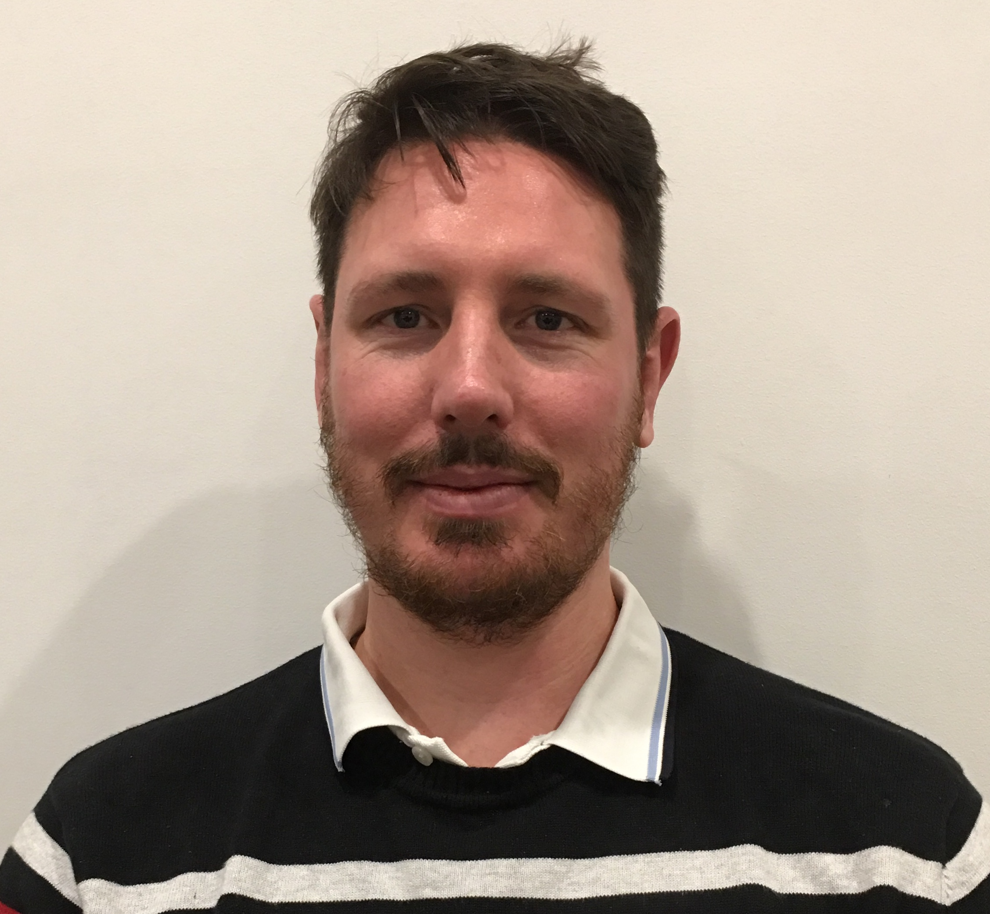
Who am I?
Richard Dobson
Back-end developer
I was responsible for researching potential open-source methods of extracting file metadata on the command line, and then helping to implement the python libraries that were ultimately chosen

Slide 3

Should you invest?
Yes
Because the metadata extraction and searching capabilities in this program have so many applications for cybersecurity
Global cybersecurity spending predicted to exceed $1 Trillion over the 5 years 2017-2021 (Cybercrime Magazine, 10/06/2019)

Slide 4

Future Improvements
Multi-threaded performance
Use existing .csv as input file
ASCII progress bar in CLI
Increased support for atypical/ non-media file types
Support for MacOS and Win 10
Better cmd line error handling
Front end improvement #1
Front end improvement #2
Front end improvement #3

Slide 5
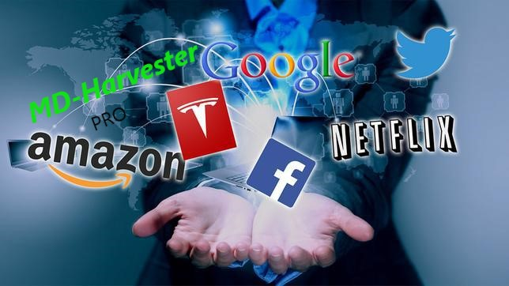
Vision for the company
Fast-growing tech startup
Office locations all around the world
Cutting edge file detection and attribute harvest capabilities
Industry-leading GUI and CLUI design
Mobile, Cloud, SAAS, Big Data…

Slide 6
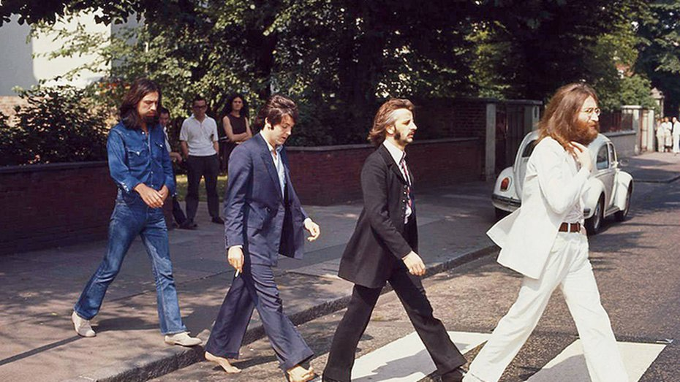
Conclusion
Thank you on behalf of the whole team for the opportunity to deliver this project
Learned a lot of lessons
Now looking forward to implementing that learning and improving on each iteration
We’re not done yet!

